Slide 1


DEPARTMENT OF COMPUTER SCIENCE AND ENGINEERING
IV/IV(2023-2024)
SAGI RAMAKRISHNAM RAJU ENGINEERING COLLEGE
Resume Screening Classification
-An Application for Resume Screening
Presented By:
Yalla Bhanu Karthik(20B91A05W0)

Slide 2

OUTLINE
Abstract
Introduction
Literature Survey
Libraries and technologies used.
Design of the Project
Results
Conclusion and Future Work

Slide 3



ABSTRACT
Resume screening is the process of assessing candidates' resumes to determine their suitability for a particular position. The purpose of resume screening is to identify the most qualified candidates who meet the requirements for the job. Conventionally, resume screening has been a manual process, with hiring managers spending significant time reviewing each resume individually. Besides the fact that it is a time-consuming procedure, there are also unknown biases. Therefore, it is important to research the methods for automating resume screening using Artificial Intelligence and Machine Learning. The first phase pre-processes the dataset and extracts resume content by using feature extraction. The second phase applies “selection” and “rejection” classification by applying a matching score algorithm and custom logic. To validate its approach, designed a unique Prospect dataset with approximately 5,000(thousand) resumes, which incorporates different data sets to generate an unbiased classification output. Experimental result shows that the Prospect model categorizes the resume in “selected” and “rejected” categories with a 93.5% accuracy which improves the overall accuracy by 19.5% compared to convolutional neural network models.

Slide 4
INTRODUCTION
A Resume is unstructured data and extracting information is a complex process. Natural language processing with complex patterns/language analysis techniques have been used for feature extraction. Feature extraction, Cosine similarity, and Levenshtein Distance have been mainly used to get the classification result. Matching with a similarity score is further provided to a model and custom logic is overlayed to get the final result. There is some level of flexibility purposely added to avoid resume rejection in favor of selection, which further with supervised learning can be reduced. The whole of the Artificial Intelligence/Machine Learning implementation is done using Python. Some of the important libraries that are used are sklearn, fuzzyWuzzy, numPy, pandas and spaCy. The level of flexibility is made configurable and customizable for the organization, which provides further flexibility for using the Resume Screening application. To perform the resume screening, it is important to make it user-friendly and to expose the Artificial Intelligence and Natural Language Processing based model to the web. It is achieved through Django in Python, with this it is just a few clicks that predicts the resume results. A bulk model is also built which performs the matching for “n” number resume at a time. This provides speed to the tool and the whole screening for a hiring drive can be done in just a few minutes which conventionally takes days and weeks. Additionally, a dashboard is also built which does the relative ranking for the resume. This product is being piloted at some esteemed organizations for further learning for machines.

Slide 5
LITERATURE
SURVEY
Year of Publishing | Authour | Title | Algorithms Used
2021 | A. K. Sinha, Md. Amir Khusru Akhtar and A. Kumar | Resume Screening Classification using Artificial Intelligence and Natural Language Processing | Random Forest (RF) Multinomial Naive Bayes (MNB) Logistic Regression (LR) Linear Support Vector Classifier (LCVC) XG Boost

Slide 6

LIBRARIES AND TECHNOLOGY USED
Deep Learning:
Algorithms used for classification and detection:
Random Forest (RF)
Multinomial Naive Bayes (MNB)
Logistic Regression (LR)
Linear Support Vector Classifier (LCVC)
XG Boost

Slide 7
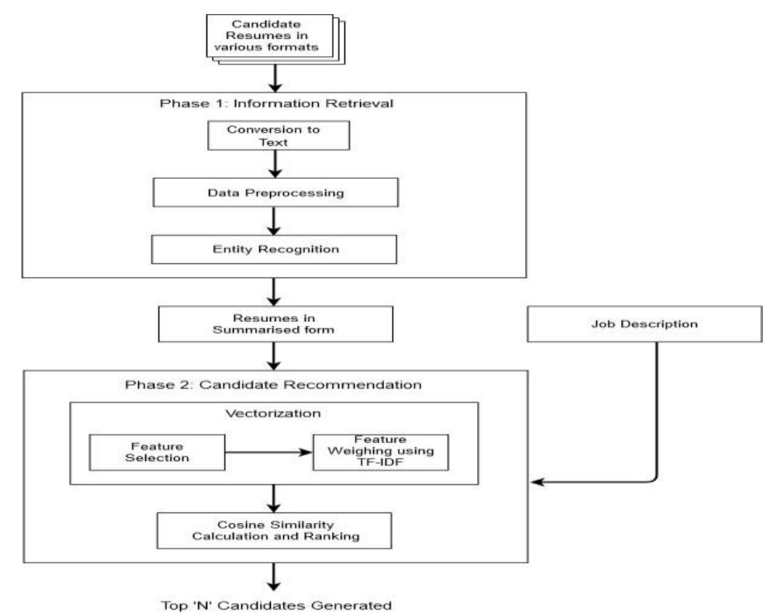
DESIGN OF THE PROJECT

Slide 8
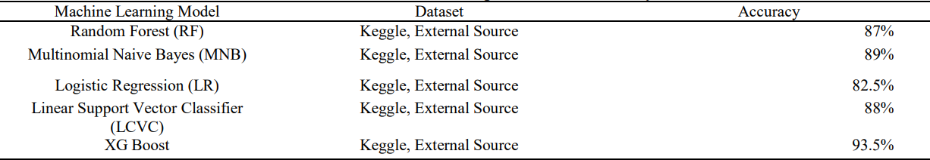
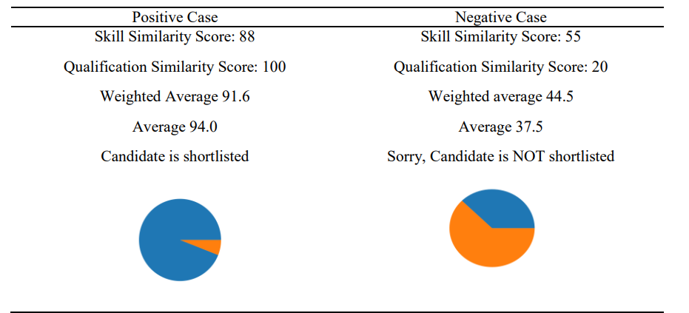
RESULTS

Slide 9

CONCLUSION
The first phase extracts the features from resume using Artificial Iearning and Natural Language Processing. The second phase use matching algorithm to derive a score for the given resume. This project also demonstrated the final result with machine performing human like decision. Further, it elaborates on how the training is provided on the extracted data with different machine learning algorithm that provides insights for key decision making. Spacy , transformers and other key libraries usage have been explained in details. This also highlights the key differentiator that this tool offers in comparison with other available tools in terms of features and accuracy. As part of next step, further regression to be performed to arrive at better accuracy in terms of shortlisting score. There is additional tunning in the dataset by web scrapping of professional network sites to be considered. There will be some outliers that will require to be eliminated for better outcome.

Slide 10
FUTURE SCOPE
Enhanced Classification Accuracy
Additional Outlier Categories
Advanced Image Processing Techniques
Integration with External Data Sources
User Personalization and Recommendations
Mobile Application Development
Research and Innovation

Slide 11


QUESTIONS

Slide 12
THANK YOU

